Slide 1
Pump It Up Project
Machine Learning Prediction of Status of Waterpoints
Author: Mercy Ngila

Slide 2


Slide 3
The problem
Client: Government of Tanzania In partnership with UNICEF
Problem Statement
Water shortage in Tanzania has been a problem for years now.
As part of its Vision 2025, the Government of Tanzania has pledged to increase access to improved sanitation to 95 per cent by 2025.
UNICEF is working with the Tanzanian Government and development partners on ensuring sustainable and equitable access to safe drinking water in rural and periurban areas.
Nangila Analytics, has been contracted to create a machine learning (ML) model to predict conditions of water points in the region

Slide 4
Objectives
Objective 1
Objective 2
Objective 3
To build a ML model that predicts the conditions of water pumps with an acceptably high accuracy.
To compare different ML models predictions to achieve highest accuracy
To advice on the best investment strategy

Slide 5
Best ML model to predict water points conditions
Random Forest
Decision Trees
Logistic Regression
Best Investment Strategy
Business Problem
Data
Methods & Evaluation
Conclusion
Recommendations
Taarifa waterpoints data
Summary

Slide 6
Data
Data from Taarifa Water points dashboard
Aggregated data from the Tanzania Ministry of Water

Slide 7
Key Factors
Water Points Status
Water Quality
Extraction Types
Regional Distribution

Slide 8
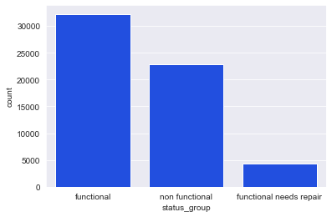
Status
There are more functional waterpoints
Water points that need repair are fairly few
A significant amount of water points are non functional

Slide 9
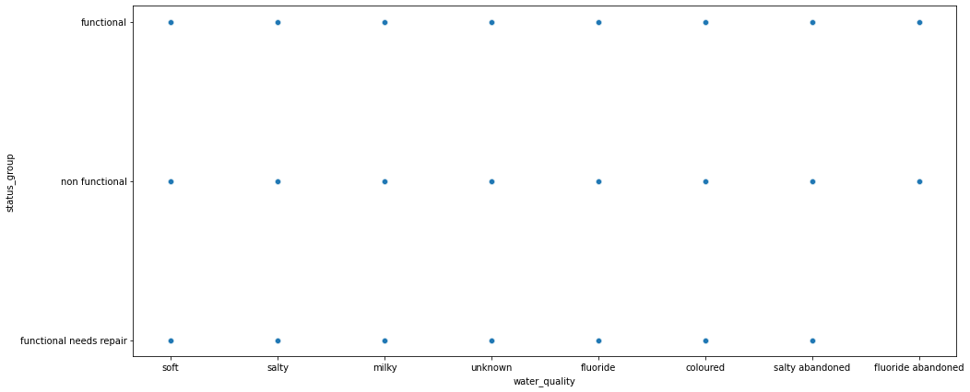
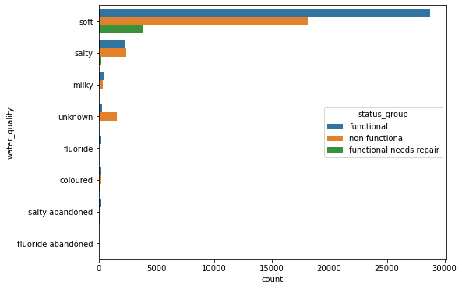
Water Quality
There are different ranges of qualities of water for functional water points.
Most of them have soft water though
Some functional water points have water with fluoride contents

Slide 10
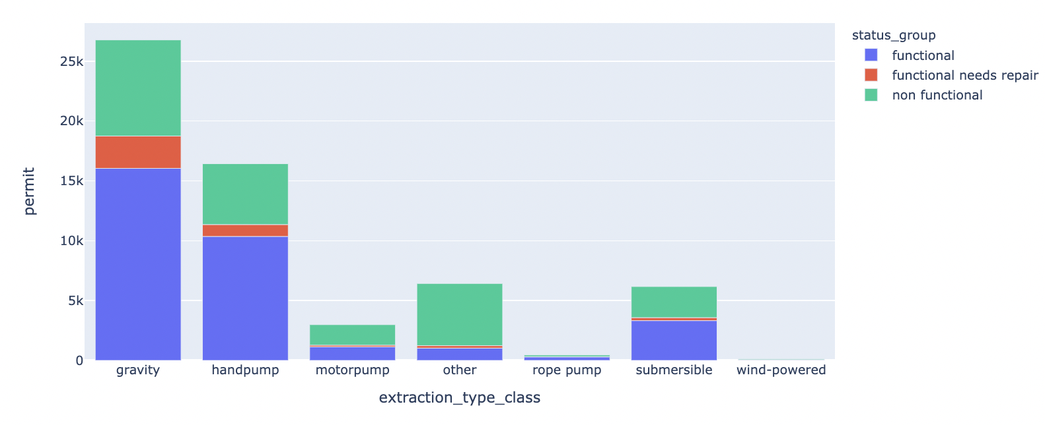
Extraction Types
Water pumps relying on gravity and hand pumps are the most functional.
Technologically advanced water pumps seem to have more non functionals e.g. motor pump
It would be a great idea to explore if fuel shortage or maintenance could be a causal factor.

Slide 11
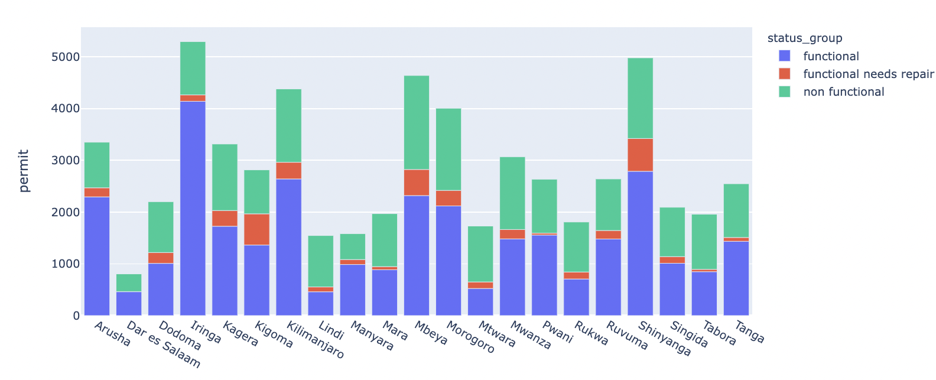
Regional Distribution
Iringa has the highest number of functional water pumps.
Most regions have more functional than non functional
The ratio of functional need repair water pumps is smaller for all regions

Slide 12
Best Model
Random Forest Model
Accuracy = 80.03%

Slide 13
Conclusion

Slide 14
The best model accuracy provides great insights on that aids planning, prioritising and investment.
There are different qualities of water in the different functional pumps though most have soft water
All waterpoints with huge investment costs are functional
Gravity and Hand pump water pumps are the most functional
It is concerning that there the number of non functional water pumps is a lot
Summary

Slide 15
Recommendations

Slide 16
Recommendation 1
Great investment opportunity to make repairs before they turn non functional.
Recommendation 2
The repairs should however be accessed to know if it is cheaper repairing or having a new one.
Recommendation 3
investigation into highly technical water pumps to understand if communities need training on usage and if they are sustainable due to costs involved. e.g Fuel Purchase

Slide 17
Recommendation 4
Priority could be placed on high population areas to get more access to water and monitoring their water pumps.
More research could be done to understand what causes water pumps to be non functional. This could help avoid setting up new water pumps in areas where there were already.
Recommendation 5

Slide 18
The End

